Slide 1

Circular Economy and State Action Plan on Climate Change (SAPCC)
- Balaji Vharkat, UNICEF Maharashtra

Slide 2
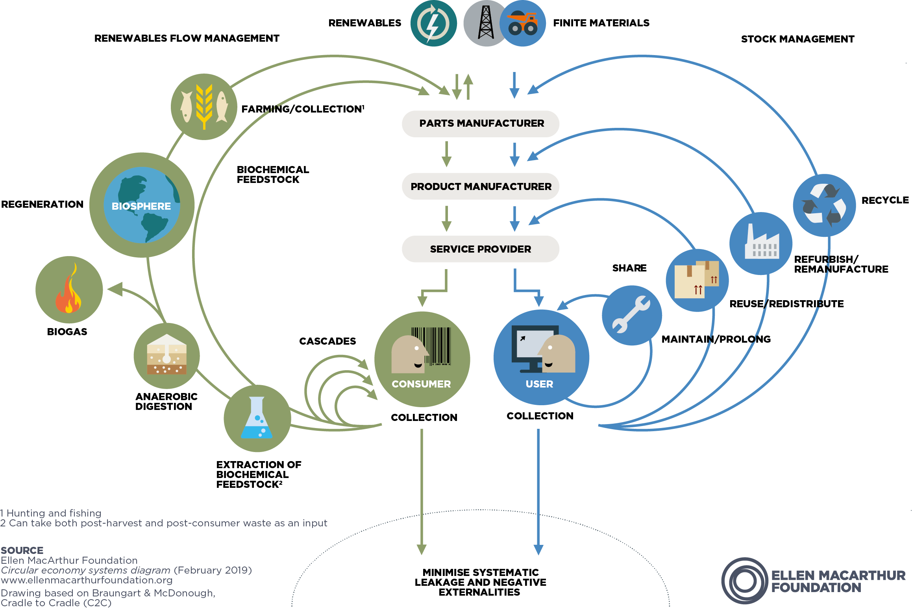
A link between Circular Economy and SAPCC
PEOPLE
Social Ways
Quality of life
PLANET Environmental Ways
Air and water quality
PROSPERITY Economic and Financial Ways
Revenue and cost
Unemployment rate
Gender equality
Income
Relative poverty
Higher education
Average commute time
Crime
Life expectancy
Energy consumption
Natural resources
Solid and toxic waste
Land use and landcover
Efficiency and productivity
Organizational size and value
Organizational growth
Employment distribution by sector
% of organisations per sector
Revenue by sector and Profit margin
Components addressed by SAPCC
Circular Economy

Slide 3
Circular Economy PRINCIPLEs-SAPCC (Programs and Impact)
Reduce Waste and Pollution
Circulate products and materials
Regenerate nature
National level mission, Localisation of SDGs and state schemes
PM Awas, CM Awas, Shabari Awas, Thakkar Bappa, etc.
Maharashtra Electric Vehicle Policy
Smart Cities Mission AMRUT 2.0
Maharashtra State New Housing Policy and Action Plan
Swachh Bharat Mission
E-Waste (in process)
Waste-Water Reuse Pol
MJP, Meenatai Thakare Pa. sa.
Tourism and Agro-tourism policies
Districts and cities preparing district environment plans
Mumbai CC action Plan, CDMP, district cooling and heatwave plans, etc.
Increased E-Vehicles
Increased Solar usage at individual, communities and industry level
People opting to organic and NBSs
Climate Finance- considered in the annual budget
Enhanced Energy Efficiency; KUSUM, Net Metering
Sustainable Habitat; houses, transport and mobility, WSS, health, SWM, tourism, etc.
Water Mission; JJM, ABhY, Catch the rain, etc.
Green: Green PHCs,
Sustaining the Ecosystem:
Sustainable Agriculture-PoCRA, PMKSY, etc.
SKMCC- Capacity Building, awareness, handholding, etc.
Notes:
Maharashtra ranks 3rd on CEEW's Climate Vulnerability Index (CVI) and is one of the most vulnerable states to extreme hydro-met disasters in India

Slide 4
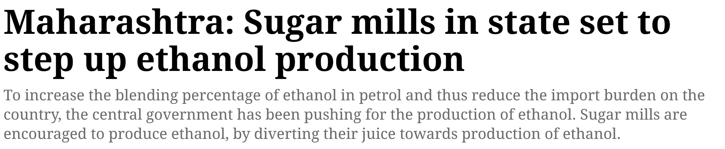
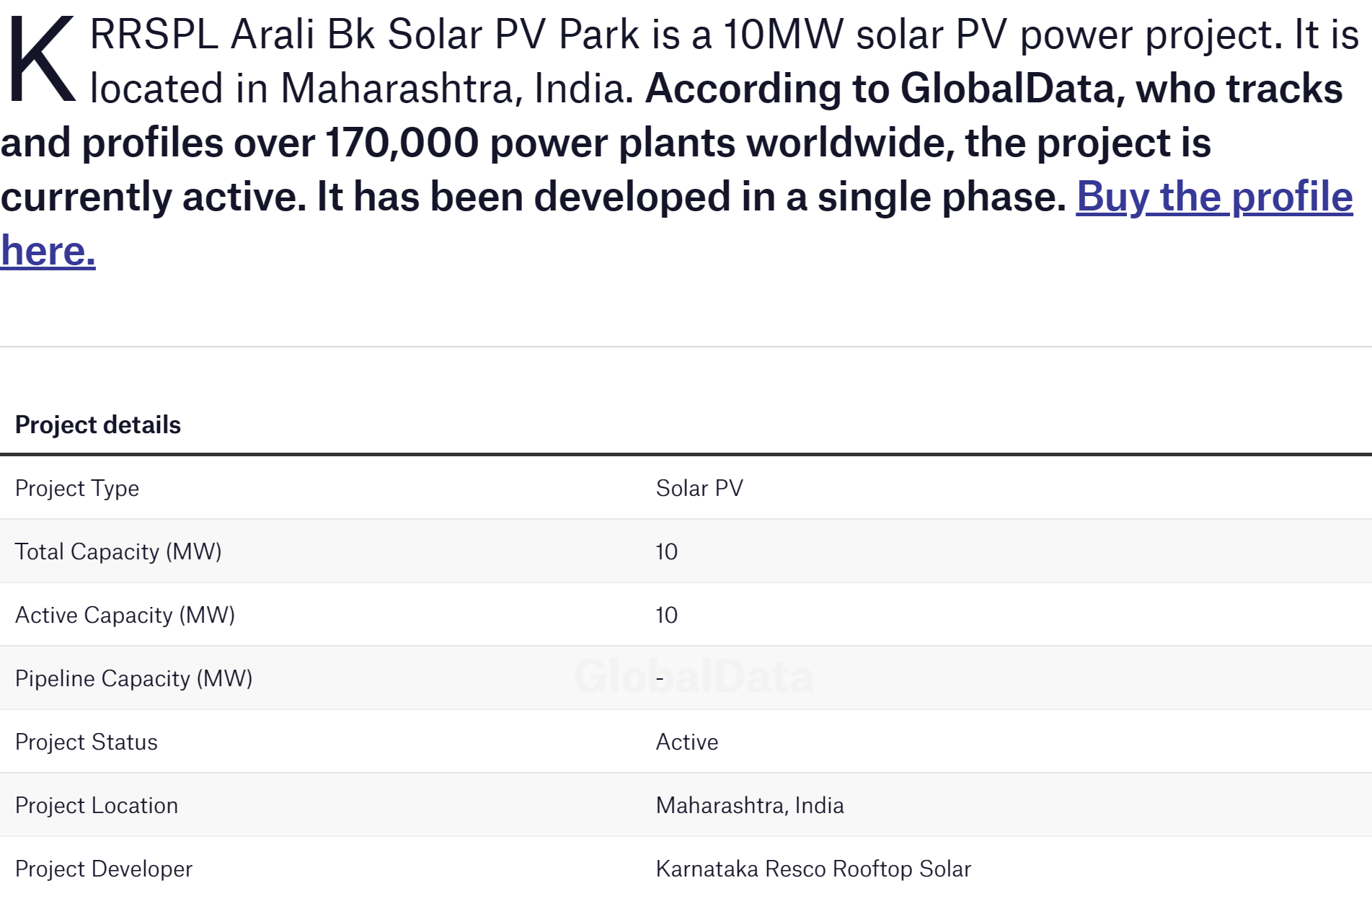
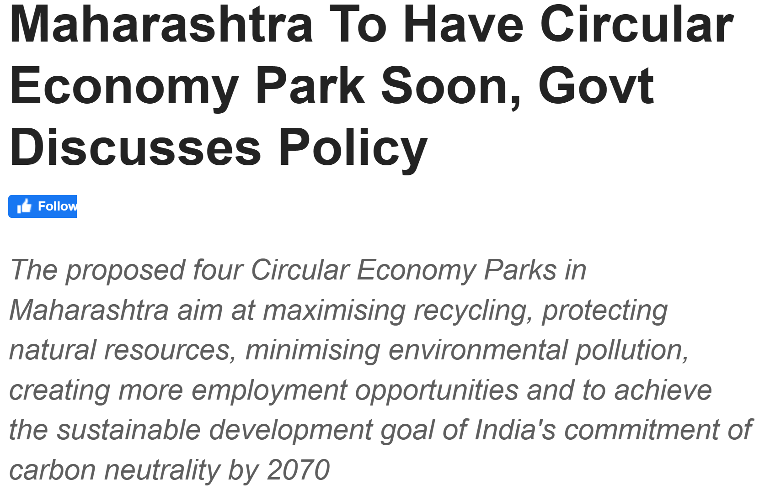
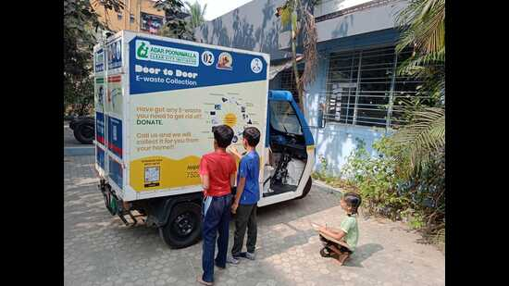
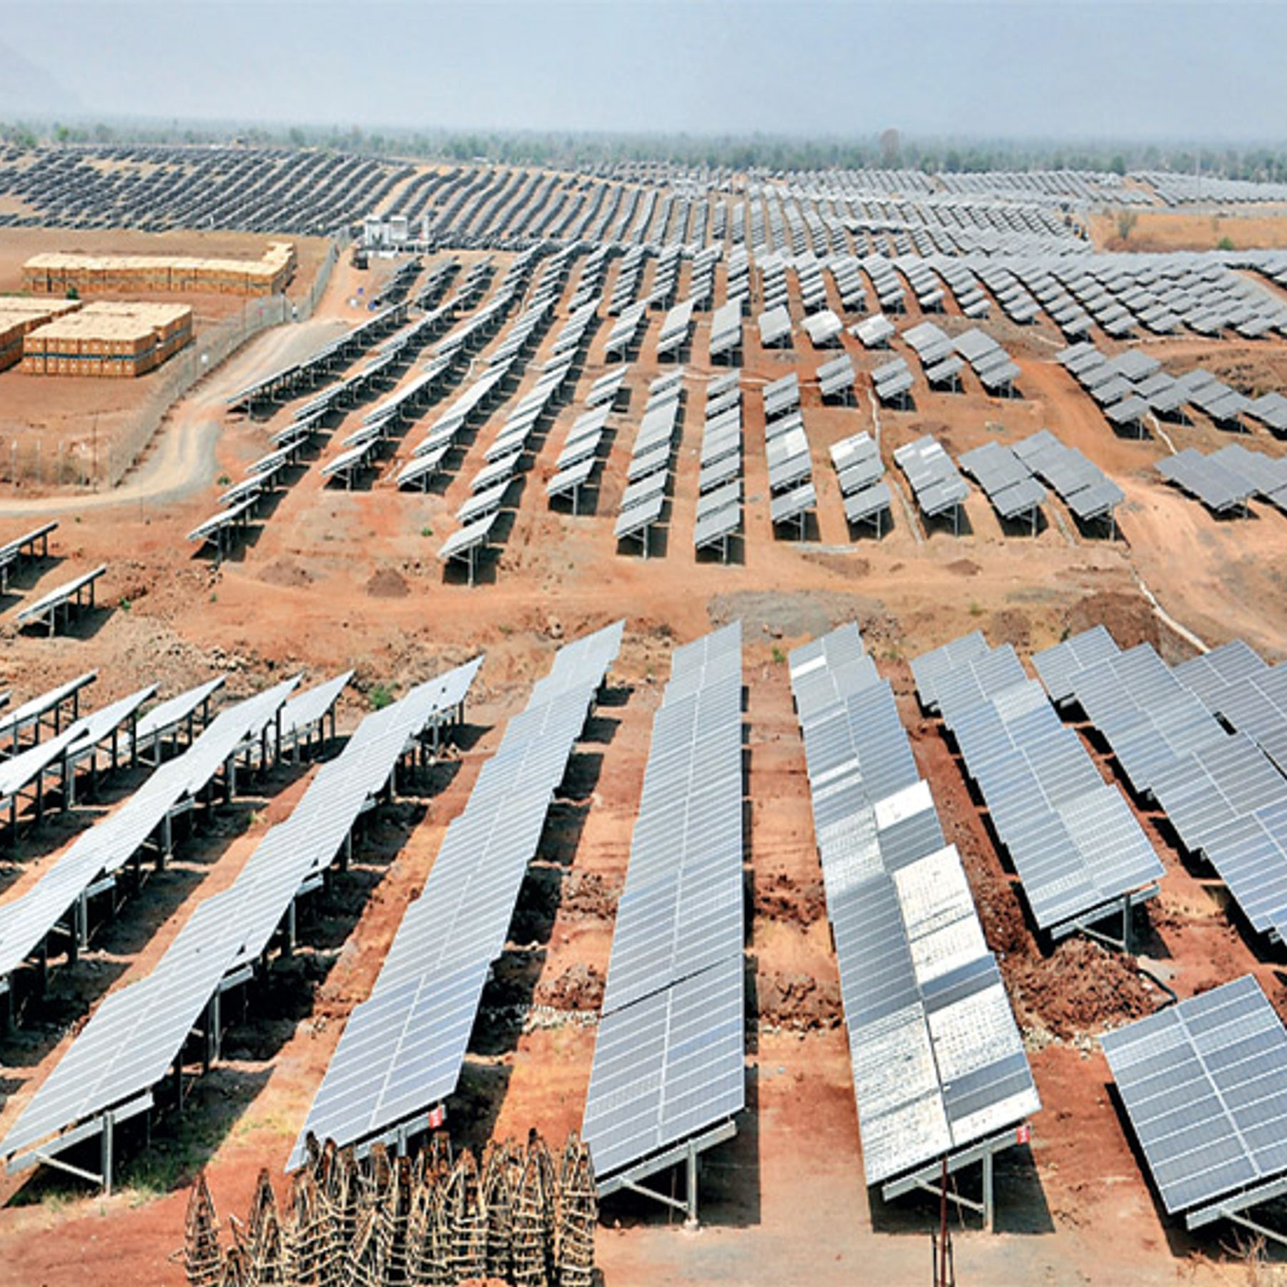
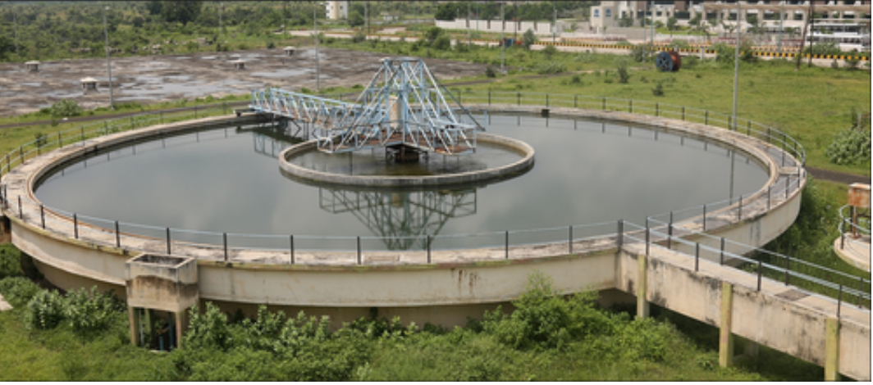
Examples of Circular Economy initiatives in different sectors

Slide 5
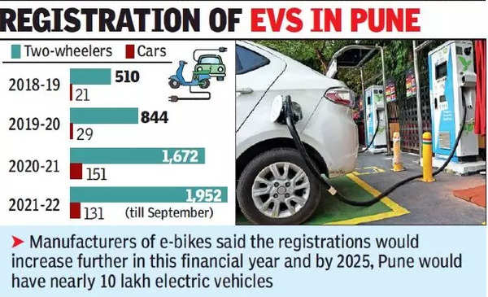
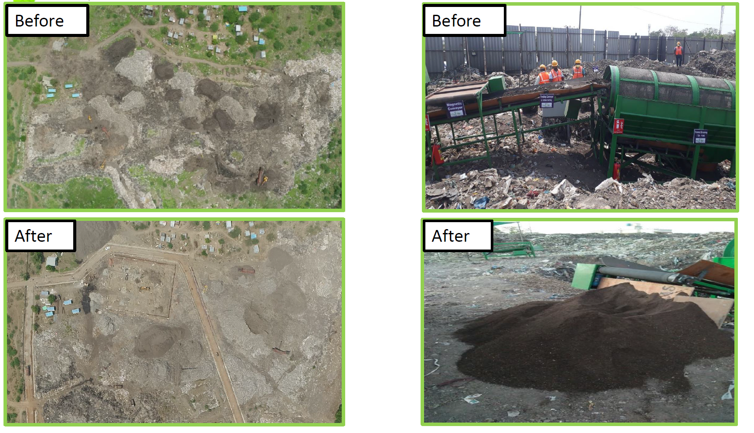
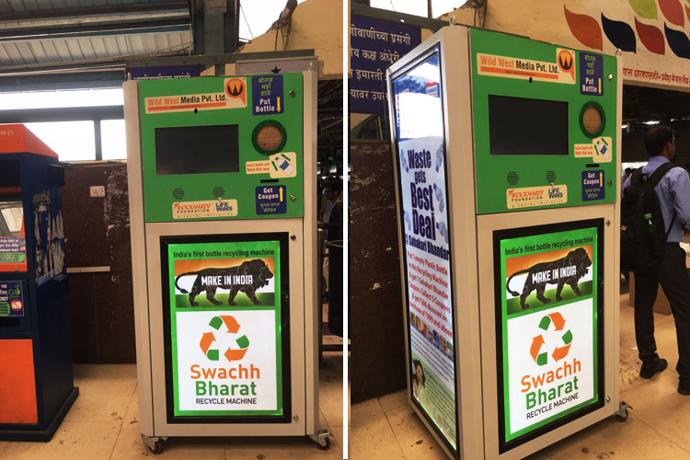
Examples of Circular Economy initiatives in different sectors

Slide 6
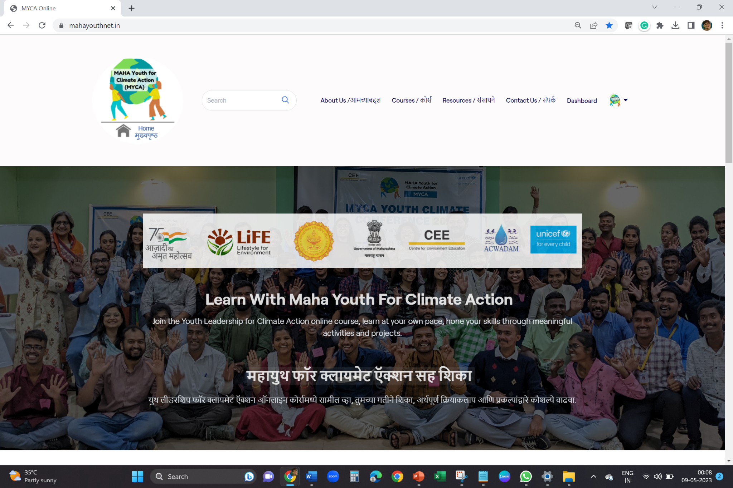
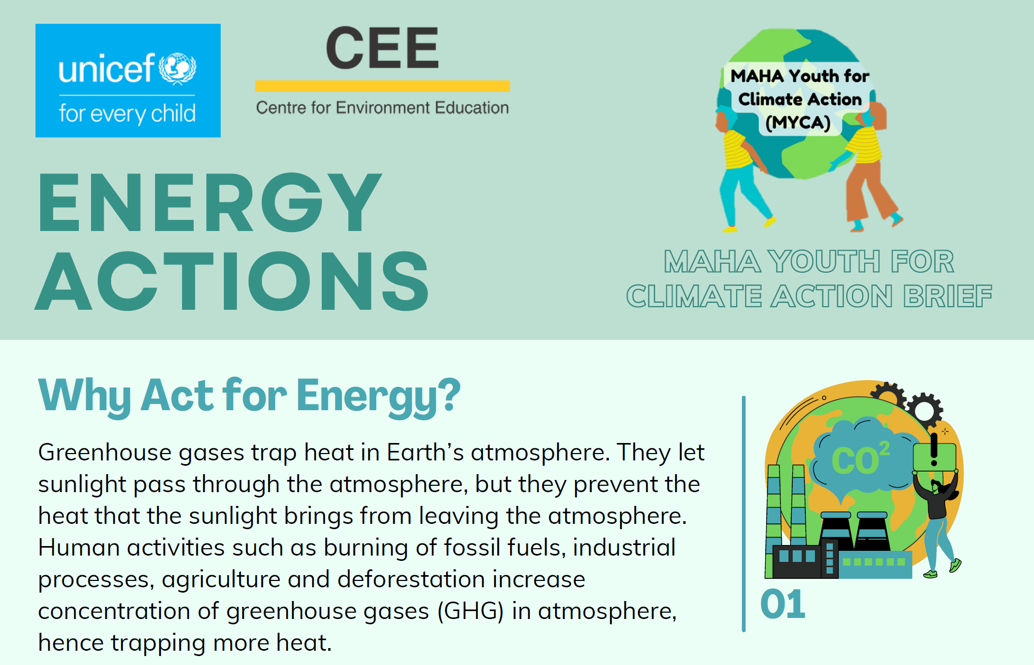
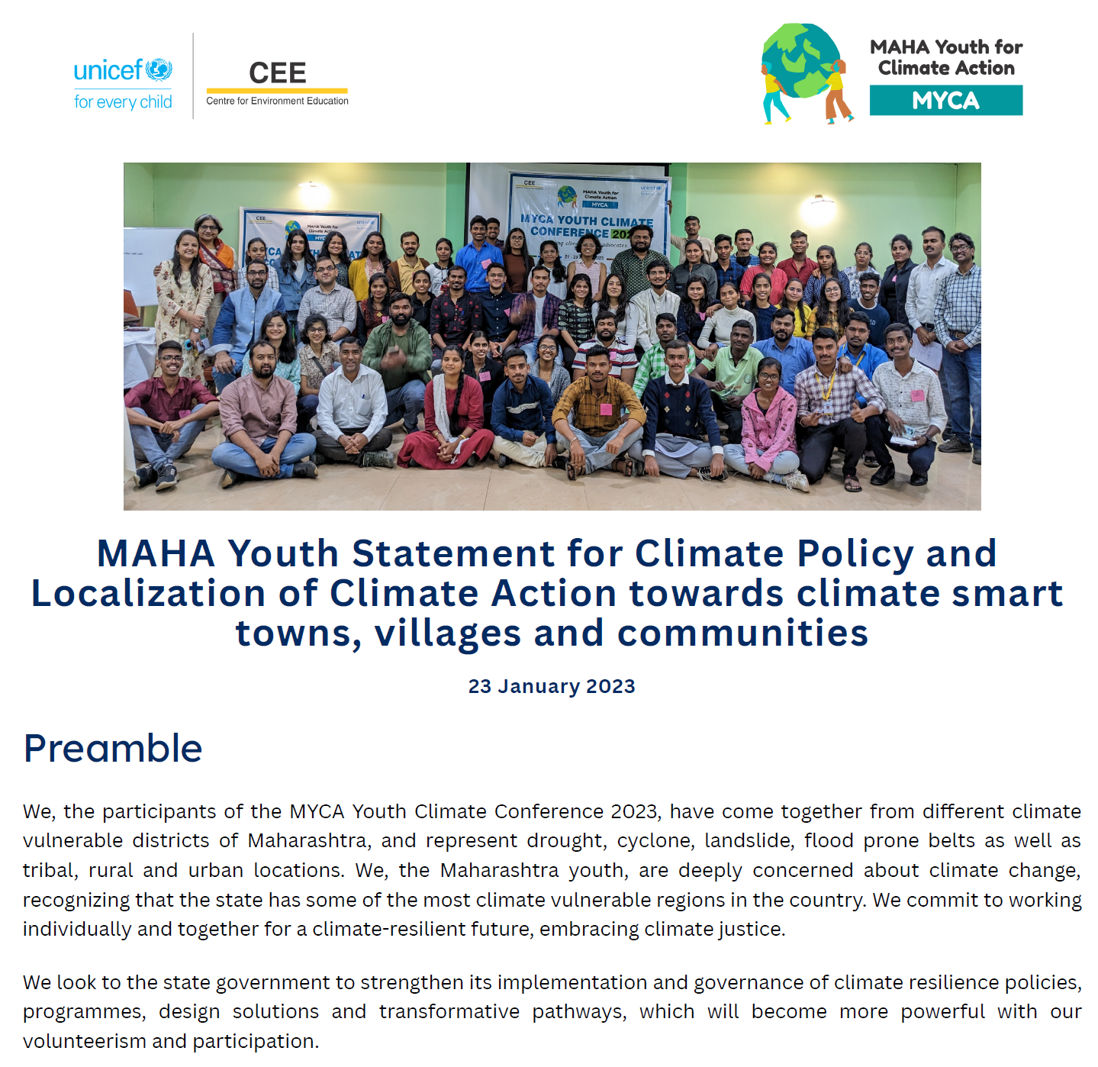
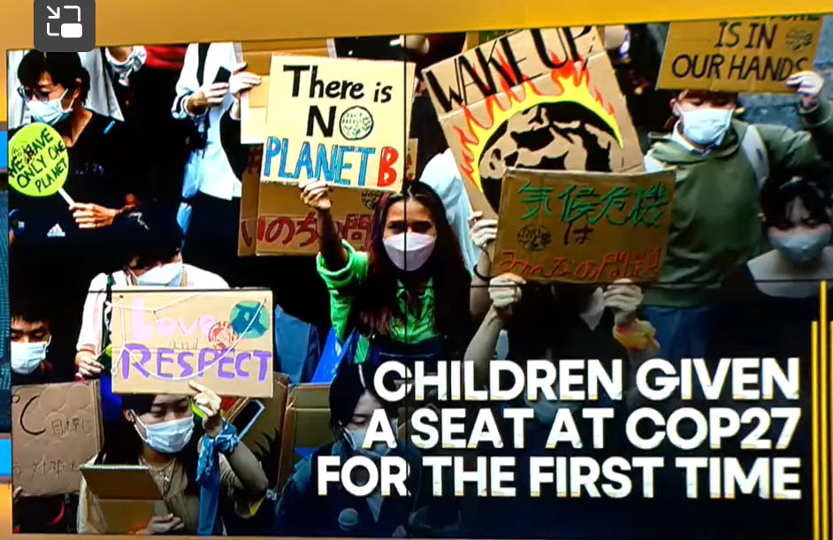
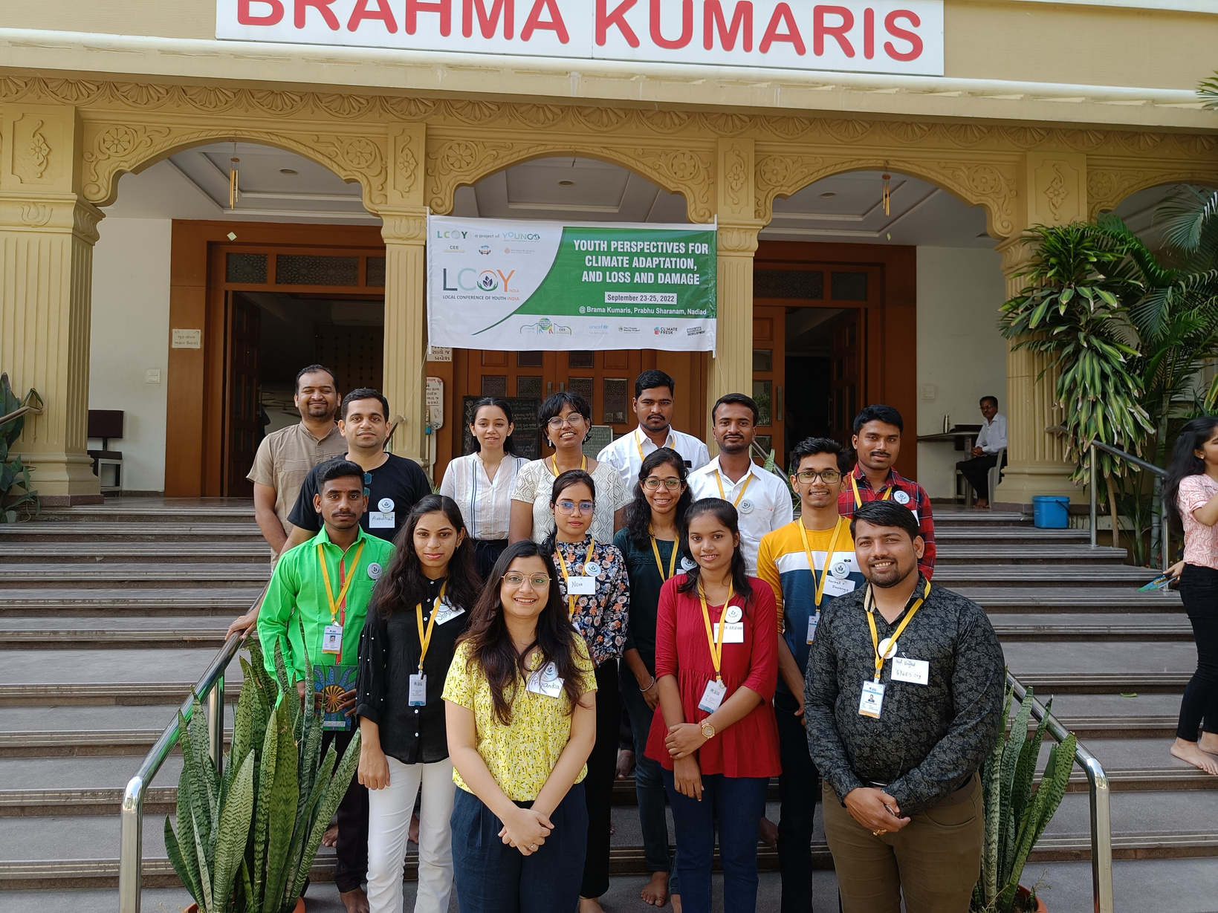
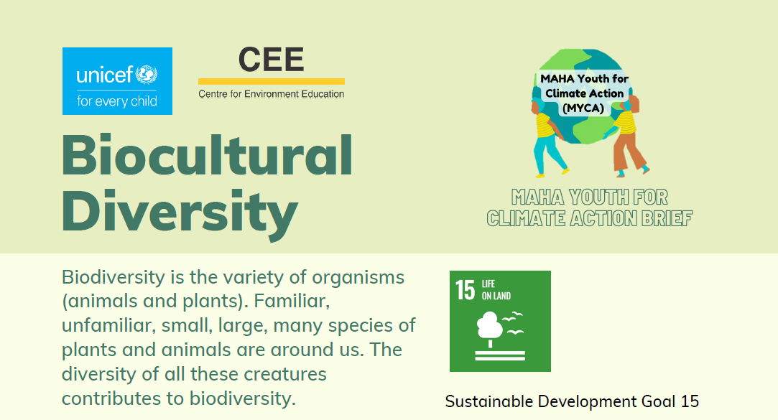
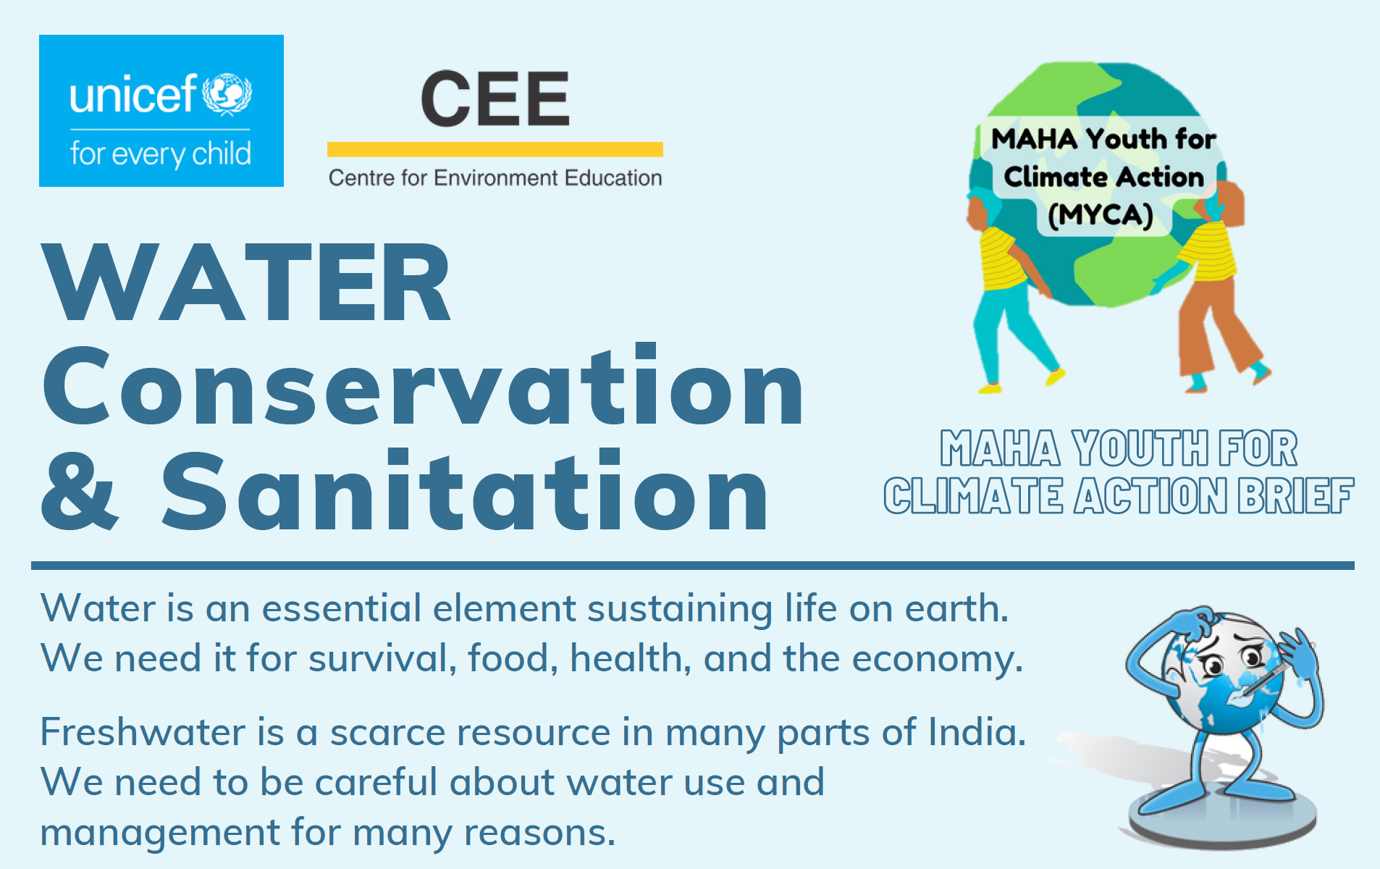
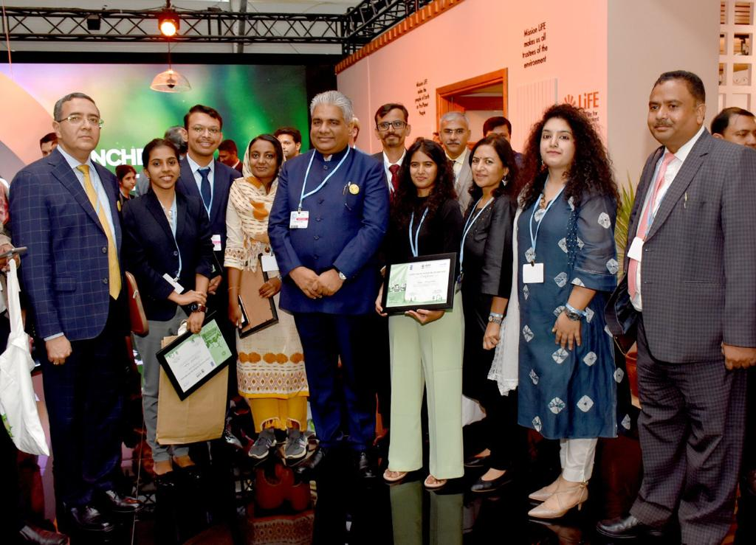

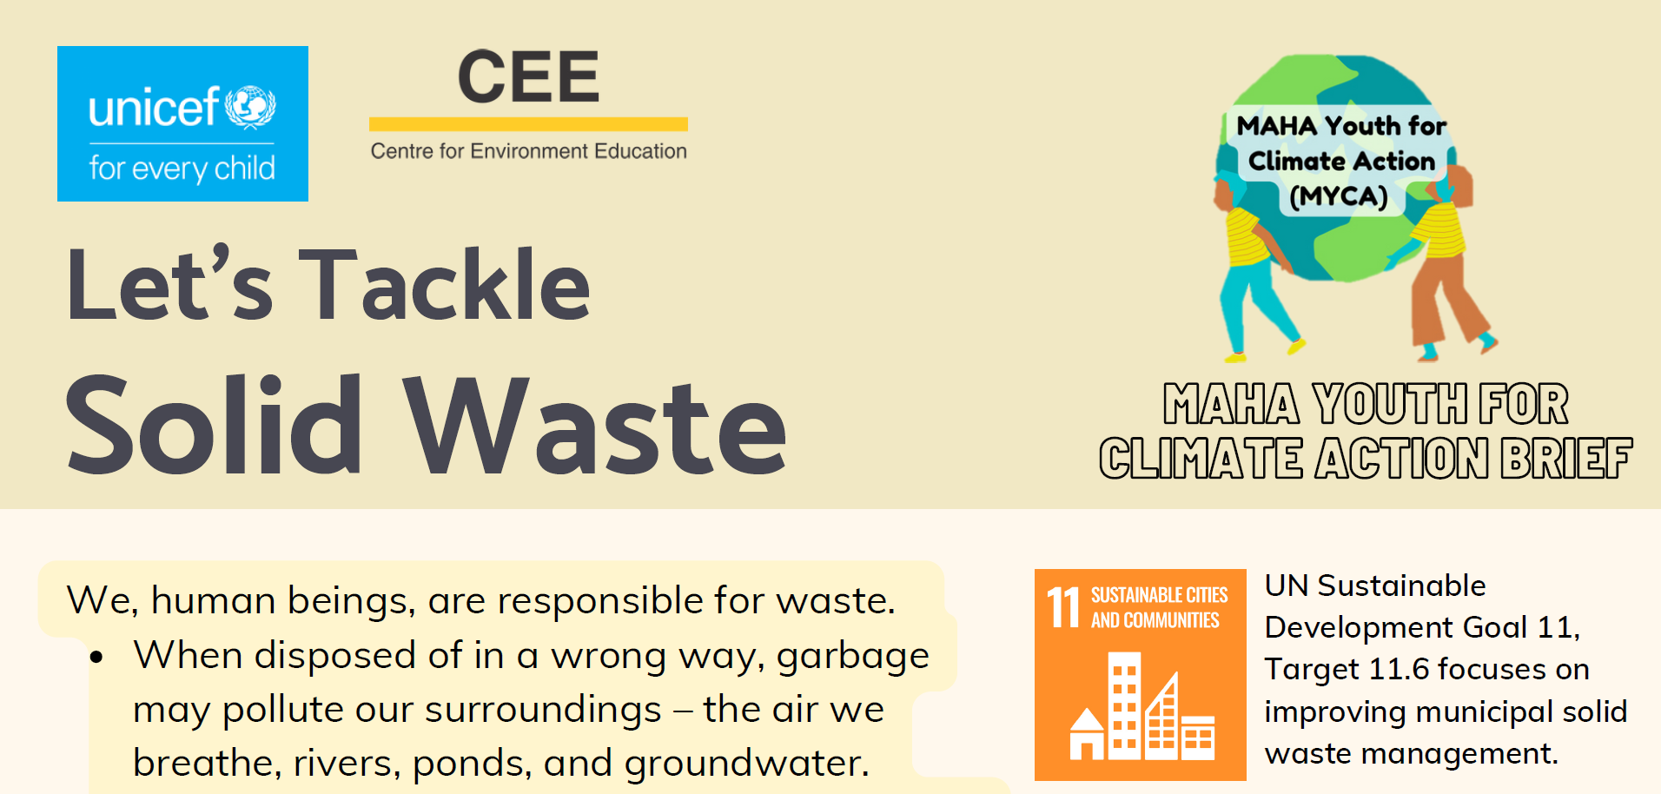
Act towards promoting the Circular Economy and SAPCC 1
Course link and QR code MYCA Online https://www.mahayouthnet.in/

Slide 7
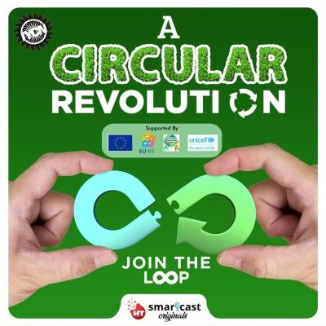
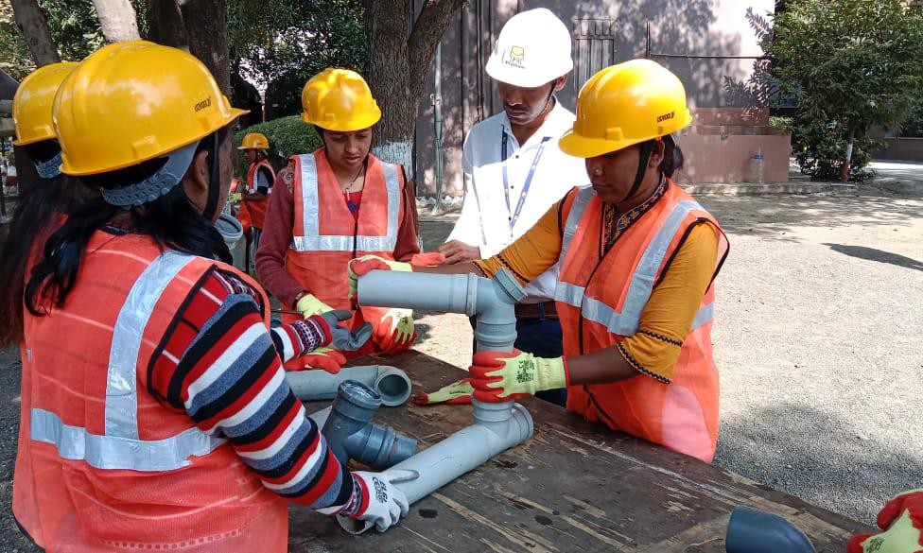

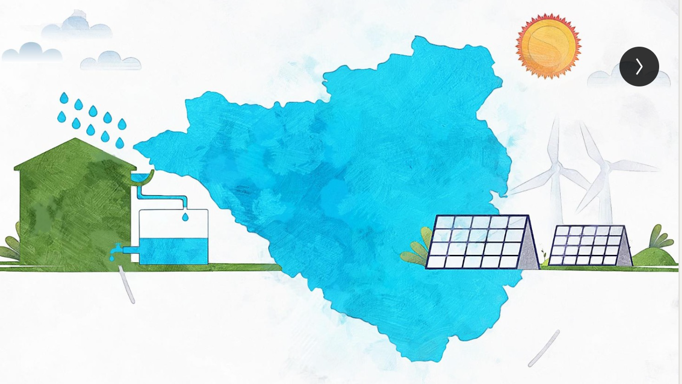
Act towards promoting the Circular Economy and SAPCC 2
List of Skilling courses | Certificate Name
Agriculture | 167
Automotive | 206
Electronics | 71
Food Processing | 52
Furniture & Fittings | 22
Hydrocarbon | 20
Infrastructure Equipment | 30
Iron and Steel | 18
Leather | 10
Life Sciences | 55
Paints and Coatings | 35
Plumbing | 6
Power | 29
Rubber | 82
Telecom | 78
Textile | 134
Tourism & Hospitality | 87
Grand Total | 1866

Slide 8
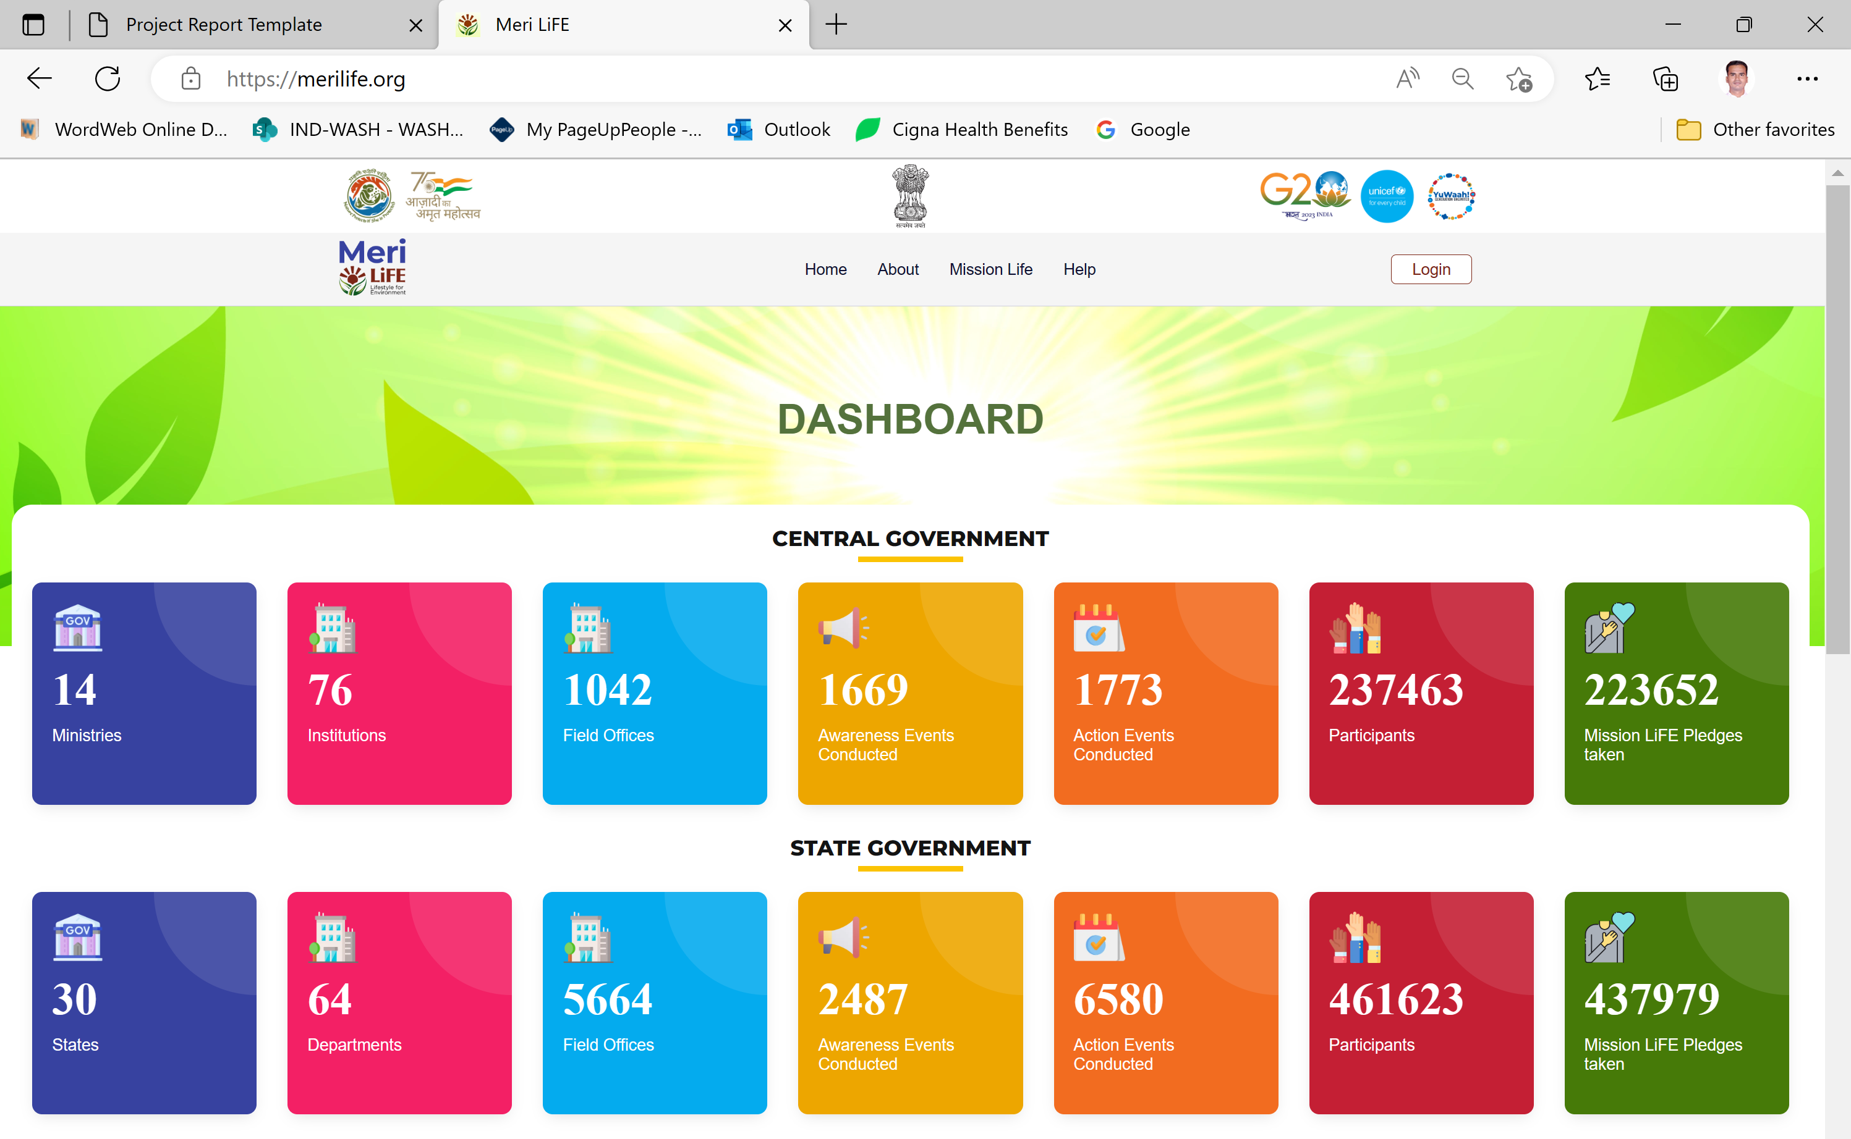

Act towards promoting the Circular Economy and SAPCC 3
Government
Citizens, Influencers, Trainers, NGOs, Paryavaran Champions, Motivational speakers, etc.

